Slide 1
SPRING CORE & DI

Slide 2
Introduction to Spring
Spring Overview
Advantage of Spring
Architecture of Spring
Core Container
Spring Container
Spring IOC Container
BeanFactory container
ApplicationContext container
Bean Definition
XML based configuration
Annotation based configuration
Bean Scopes
Introduction
Bean Lifecycle
Bean Postprocessor

Slide 3
Objectives
Sujata Batra
understanding of Spring framework.
Working of Spring container and inversion of Control(IOC)
Spring Beans configuration
Bean Scopes
Dependency Injection
Event Handling

Slide 4
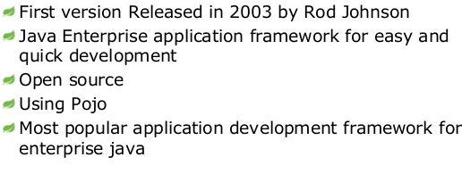
Sujata Batra
What is Spring Framework?
Notes:
Spring enables you to build applications from "plain old Java objects" (POJOs) and to apply enterprise services non-invasively to POJOs.
Spring is designed to be non-intrusive, meaning that your domain logic code generally has no dependencies on the framework itself.

Slide 5
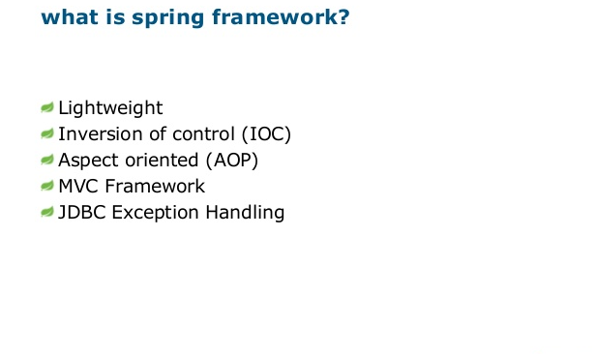
Sujata Batra
Notes:
With the Dependency Injection(DI) approach, dependencies are explicit and evident in constructor or JavaBean properties
Works on POJOs. Hence easier for dependency injection / injection of test data.
Enhances modularity.
Provides loose coupling between different modules.
Flexible use of Dependency injection. Can be configured by XML based schema or annotation-based style.
Supports declarative transaction, caching, validation and formatting.
Boilerplate reduction through aspects and templates.
Spring comes with some of the existing technologies like ORM framework, logging framework, J2EE and JDK Timers etc, Hence we don’t need to integrate explicitly those technologies.
Spring WEB framework has a well-designed web MVC framework, which provides a great alternate to web framework.
Spring framework has taken the best practice that have been proven over the years in several applications and formalized as design patterns.

Slide 6
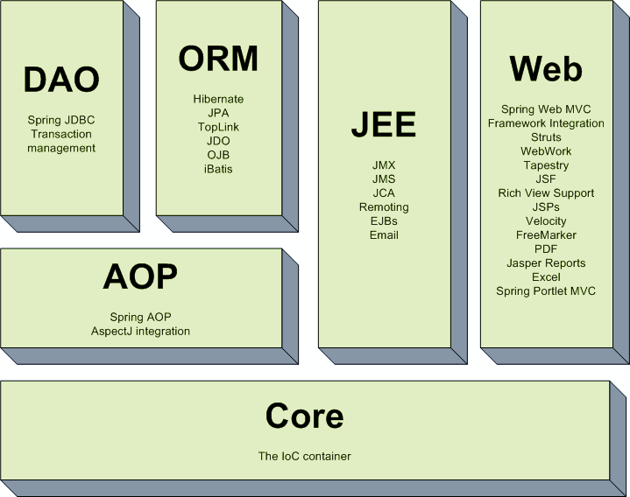
Sujata Batra
Architecture of Spring
Notes:
The Core Module: Provides the Dependency Injection (DI) feature which is the basic concept of the Spring framework. This module contains the BeanFactory, an implementation of Factory Pattern which creates the bean as per the configurations provided by the developer in an XML file.
AOP Module: The Aspect Oriented Programming module allows developers to define method-interceptors and point cuts to keep the concerns apart. It is configured at run time so the compilation step is skipped. It aims at declarative transaction management which is easier to maintain.
DAO Module: This provides an abstraction layer to the low level task of creating a connection, releasing it etc. It also maintains a hierarchy of meaningful exceptions rather than throwing complicated error codes from specific database vendors. It uses AOP to manage transactions. Transactions can also be managed programmatically.
ORM Module: Spring doesn’t provides its own ORM implementation but offers integrations with popular Object Relational mapping tools like Hibernate, iBATIS SQL Maps, Oracle TopLink and JPA etc.
JEE Module: It also provides support for JMX, JCA, EJB and JMS etc. In lots of cases, JCA (Java EE Connection API) is much like JDBC, except where JDBC is focused on database JCA focus on connecting to legacy systems.
Web Module: Spring comes with MVC framework which eases the task of developing web applications. It also integrates well with the most popular MVC frameworks like Struts, Tapestry, JSF, Wicket etc.
https://dzone.com/articles/spring-framework-architecture

Slide 7
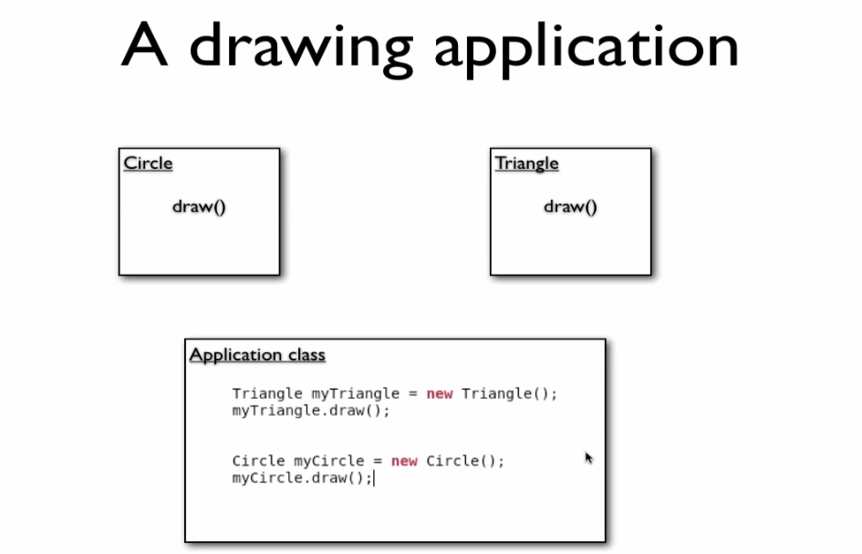
Sujata Batra

Slide 8
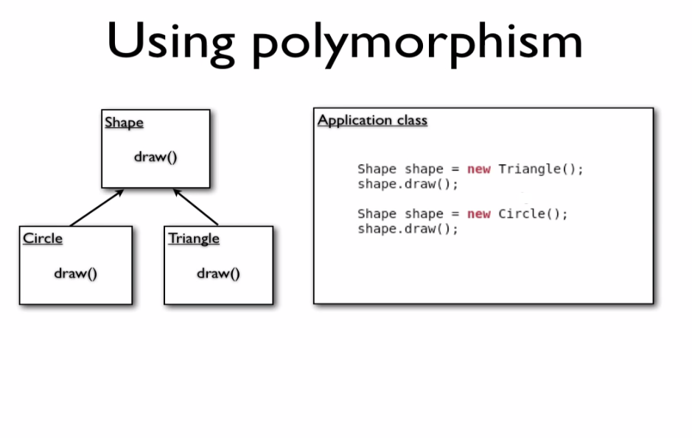
Sujata Batra

Slide 9
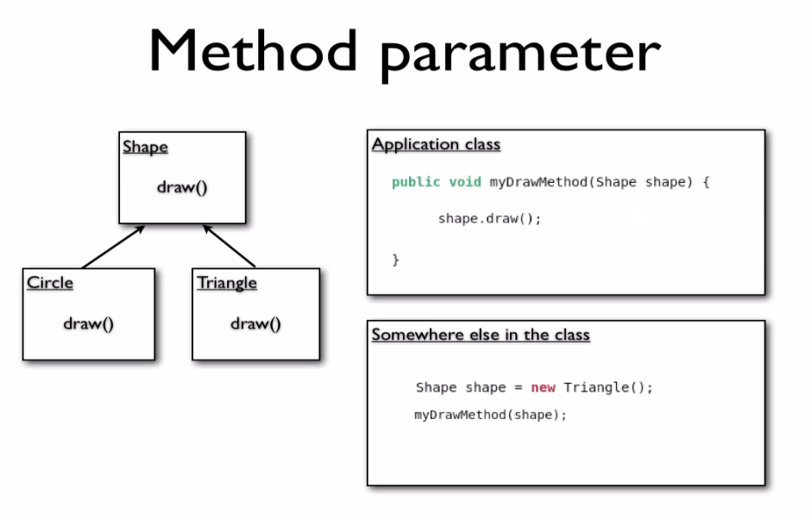
Sujata Batra

Slide 10
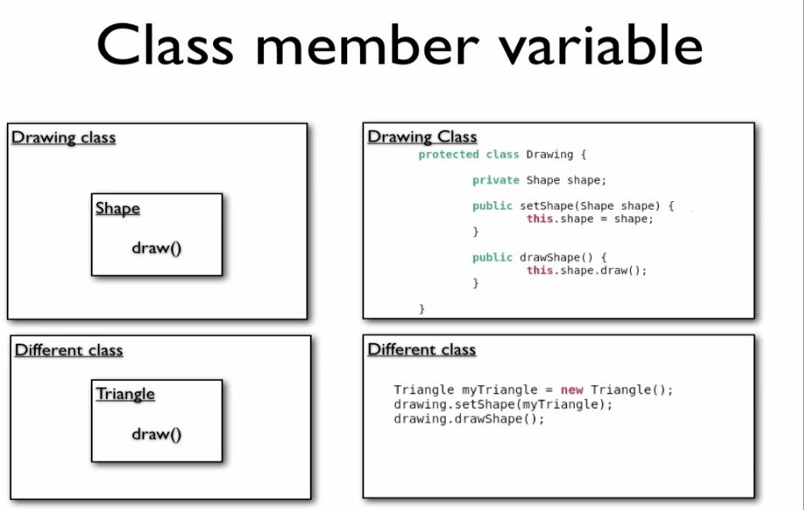
Sujata Batra

Slide 11
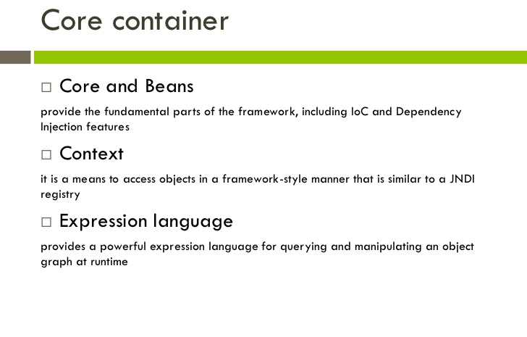
Sujata Batra
Notes:
The Core Container consists of the Core, Beans, Context, and Expression Language modules.
The Core and Beans modules provide the fundamental parts of the framework, including the IoC and Dependency Injection features. The BeanFactory is a sophisticated implementation of the factory pattern. It removes the need for programmatic singletons and allows you to decouple the configuration and specification of dependencies from your actual program logic.
The Context module builds on the solid base provided by the Core and Beans modules: it is a means to access objects in a framework-style manner that is similar to a JNDI registry. The Context module inherits its features from the Beans module and adds support for internationalization (using, for example, resource bundles), event-propagation, resource-loading, and the transparent creation of contexts by, for example, a servlet container. The Context module also supports Java EE features such as EJB, JMX ,and basic remoting. The ApplicationContext interface is the focal point of the Context module.
The Expression Language module provides a powerful expression language for querying and manipulating an object graph at runtime. It is an extension of the unified expression language (unified EL) as specified in the JSP 2.1 specification. The language supports setting and getting property values, property assignment, method invocation, accessing the context of arrays, collections and indexers, logical and arithmetic operators, named variables, and retrieval of objects by name from Spring’s IoC container

Slide 12
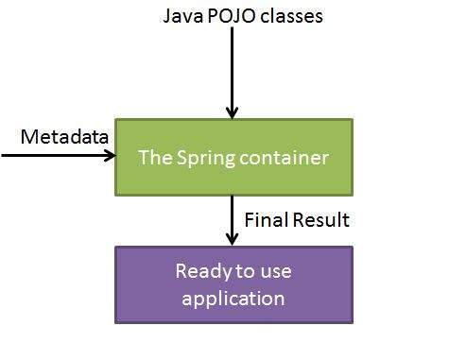
Sujata Batra
IOC container
The Spring IoC container makes use of Java POJO classes and configuration metadata to produce a fully configured and executable system or application.

Slide 13
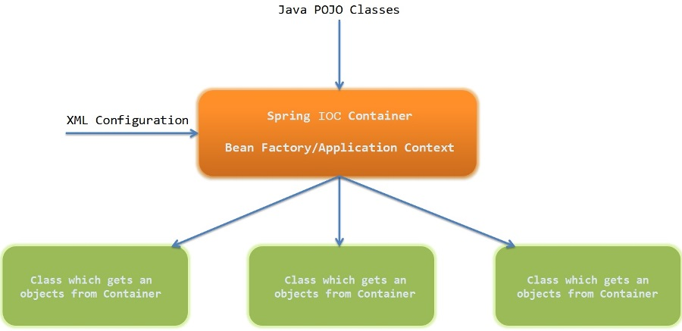
Sujata Batra
IOC container (continued)

Slide 14
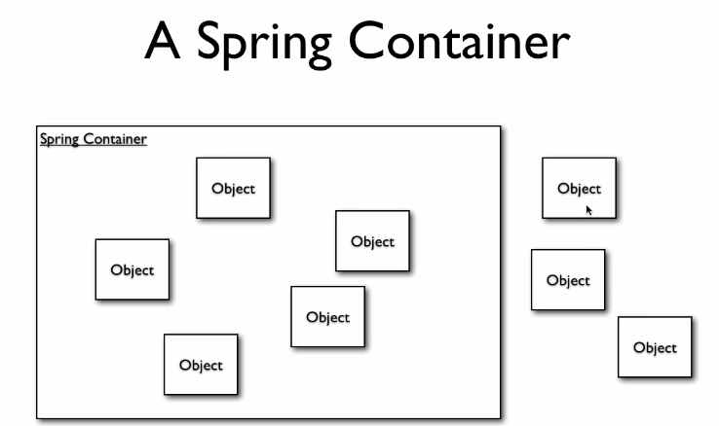
Sujata Batra
Notes:
This is the simplest container providing basic support for DI and defined by the org.springframework.beans.factory.BeanFactory interface. A BeanFactory is essentially nothing more than the interface for an advanced factory capable of maintaining a registry of different beans and their dependencies.
There are a number of implementations of the BeanFactory interface that come supplied straight out-of-the-box with Spring. The most commonly used BeanFactory implementation is the XmlBeanFactory class. This container reads the configuration metadata from an XML file and uses it to create a fully configured system or application.
The BeanFactory is usually preferred where the resources are limited like mobile devices or applet based applications.
To explain the concept we have created following 3 files :
HelloWorld.java : Simple Java POJO having just a getter and setter
MainApp.java : Creates a BeanFactory and gets HelloWorld bean
Beans.xml : XML bean configuration file

Slide 15
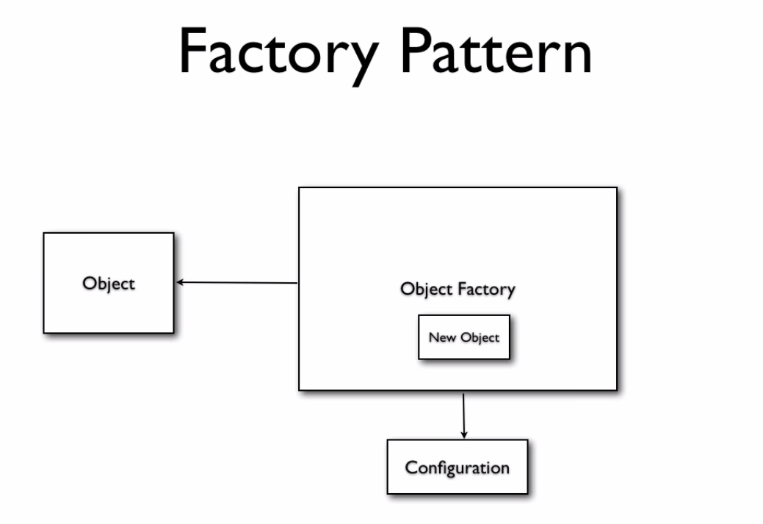
Sujata Batra
Notes:
This is the simplest container providing basic support for DI and defined by the org.springframework.beans.factory.BeanFactory interface. A BeanFactory is essentially nothing more than the interface for an advanced factory capable of maintaining a registry of different beans and their dependencies.
There are a number of implementations of the BeanFactory interface that come supplied straight out-of-the-box with Spring. The most commonly used BeanFactory implementation is the XmlBeanFactory class. This container reads the configuration metadata from an XML file and uses it to create a fully configured system or application.
The BeanFactory is usually preferred where the resources are limited like mobile devices or applet based applications.
To explain the concept we have created following 3 files :
HelloWorld.java : Simple Java POJO having just a getter and setter
MainApp.java : Creates a BeanFactory and gets HelloWorld bean
Beans.xml : XML bean configuration file

Slide 16
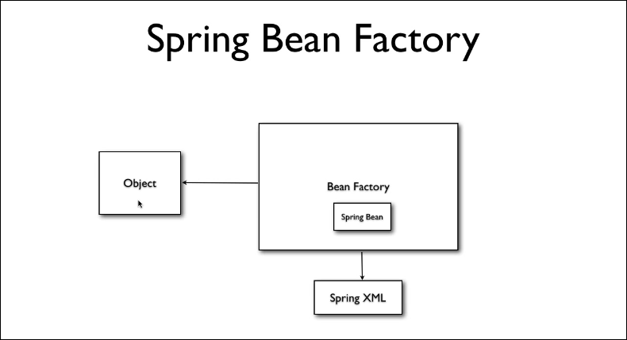
Sujata Batra
Notes:
This is the simplest container providing basic support for DI and defined by the org.springframework.beans.factory.BeanFactory interface. A BeanFactory is essentially nothing more than the interface for an advanced factory capable of maintaining a registry of different beans and their dependencies.
There are a number of implementations of the BeanFactory interface that come supplied straight out-of-the-box with Spring. The most commonly used BeanFactory implementation is the XmlBeanFactory class. This container reads the configuration metadata from an XML file and uses it to create a fully configured system or application.
The BeanFactory is usually preferred where the resources are limited like mobile devices or applet based applications.
To explain the concept we have created following 3 files :
HelloWorld.java : Simple Java POJO having just a getter and setter
MainApp.java : Creates a BeanFactory and gets HelloWorld bean
Beans.xml : XML bean configuration file

Slide 17
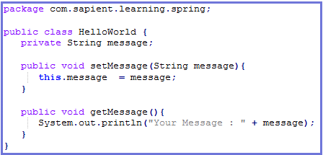
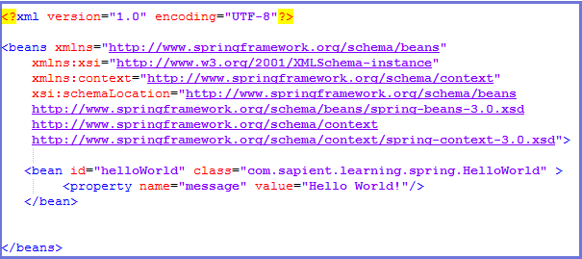
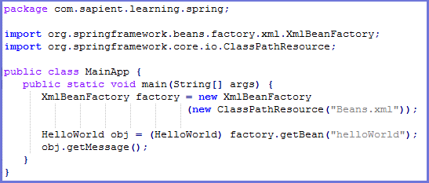
BeanFactory container contd…
HelloWorld.java
Beans.xml
MainApp.java

Slide 18
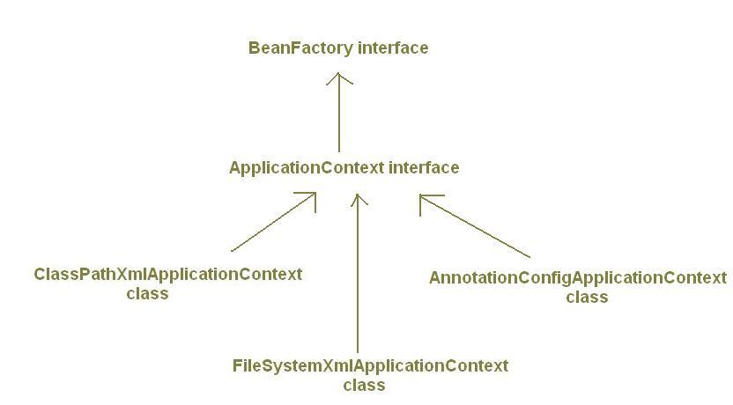
Sujata Batra
ApplicationContext
Notes:
The Application Context is spring's more advanced container. Similar to BeanFactory it can load bean definitions, wire beans together and dispense beans upon request.
Additionally it adds more enterprise-specific functionality such as the ability to resolve textual messages from a properties file and the ability to publish application events to interested event listeners.
The ApplicationContext includes all functionality of the BeanFactory, it is generally recommended over the BeanFactory.
The most commonly used ApplicationContext implementations are:
FileSystemXmlApplicationContext: This container loads the definitions of the beans from an XML file. Here you need to provide the full path of the XML bean configuration file to the constructor.
ClassPathXmlApplicationContext This container loads the definitions of the beans from an XML file. Here you do not need to provide the full path of the XML file but you need to set CLASSPATH properly because this container will look bean configuration XML file in CLASSPATH.
WebXmlApplicationContext: This container loads the XML file with definitions of all beans from within a web application.
To explain the concept we have created following 3 files :
HelloWorld.java : Simple Java POJO having just a getter and setter
MainApp.java : Creates a FileSystemXMLApplicationContext and gets HelloWorld bean
Beans.xml : XML bean configuration file

Slide 19
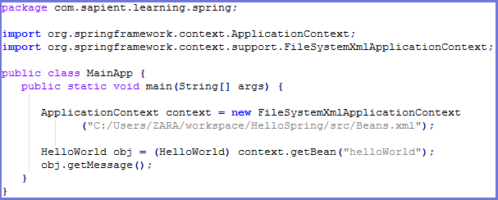
Sujata Batra
ApplicationContext container contd…
HelloWorld.java
Beans.xml
MainApp.java

Slide 20
Sujata Batra
BeanFactory vs ApplicationContext container
Feature | BeanFactory | ApplicationContext
Bean instantiation/wiring | Yes | Yes
Automatic BeanPostProcessor registration | No | Yes
Automatic BeanFactoryPostProcessor registration | No | Yes
Convenient MessageSource access (for i18n) | No | Yes
ApplicationEvent publication | No | Yes

Slide 21
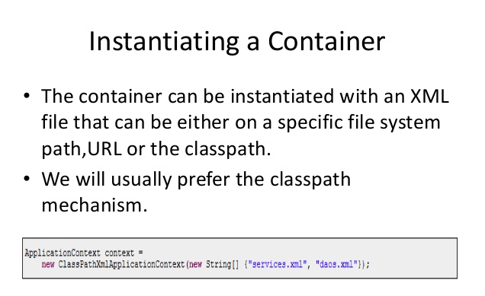
Sujata Batra

Slide 22
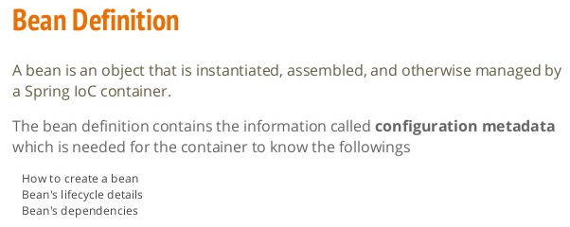
Sujata Batra

Slide 23
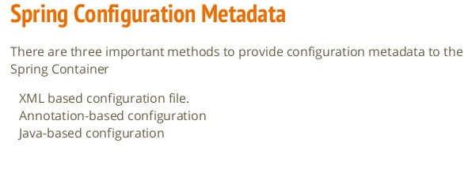
Sujata Batra

Slide 24
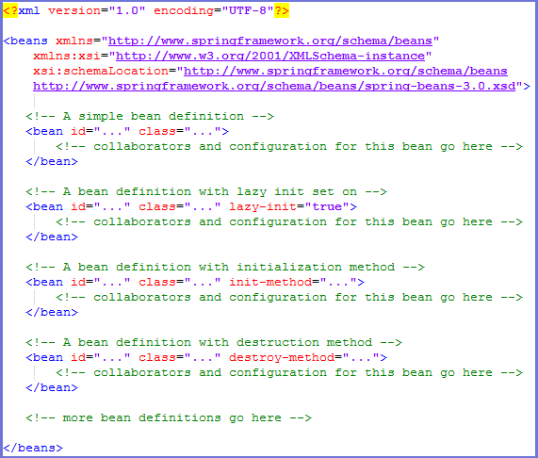
XML based configuration
Sujata Batra

Slide 25
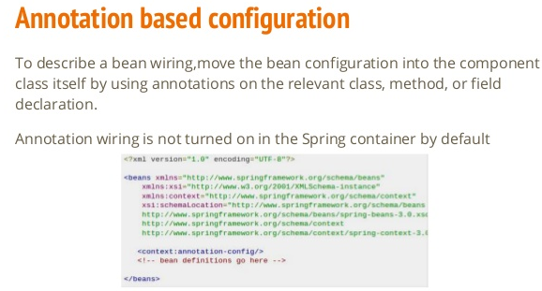
Sujata Batra

Slide 26
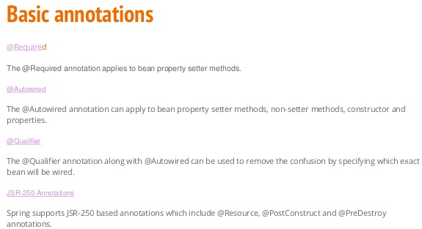
Sujata Batra

Slide 27
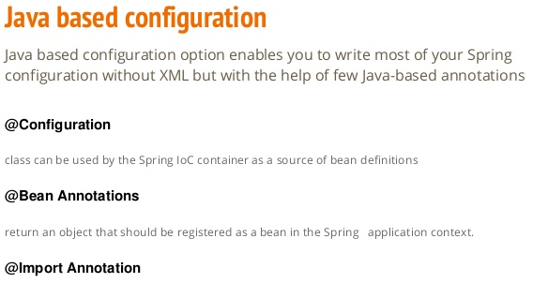
Sujata Batra

Slide 28
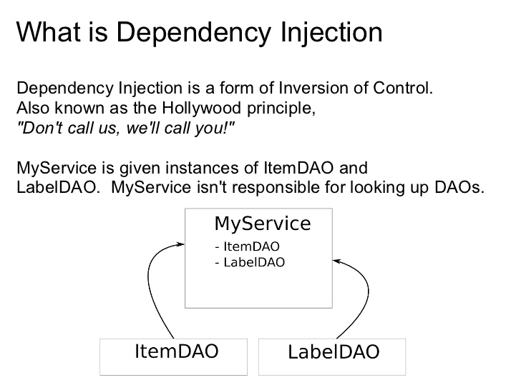
Sujata Batra
Notes:
When writing a complex Java application, application classes should be as independent as possible of other Java classes to increase the possibility to reuse these classes and to test them independently of other classes while doing unit testing.
Dependency Injection (or sometime called wiring) helps in gluing these classes together and same time keeping them independent.
DI exists in two major variants in Spring :
Constructor-based dependency injection
Setter-based dependency injection

Slide 29

Sujata Batra

Slide 30
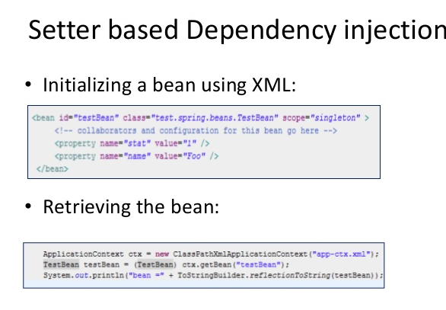
Sujata Batra

Slide 31
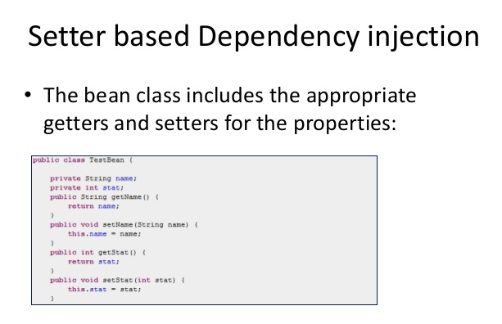
Sujata Batra

Slide 32
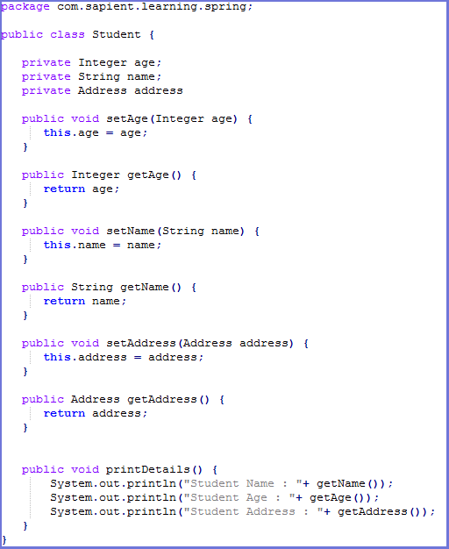
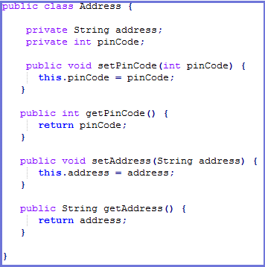
Setter-based dependency injection (Contd.)
Sujata Batra
Notes:
Setter-based DI is accomplished by the container calling setter methods on your beans after invoking a no-argument constructor or no-argument static factory method to instantiate your bean.
In case you are passing a reference to an object, you need to use ref attribute of <property> tag and if you are passing a value directly then you should use value attribute.

Slide 33
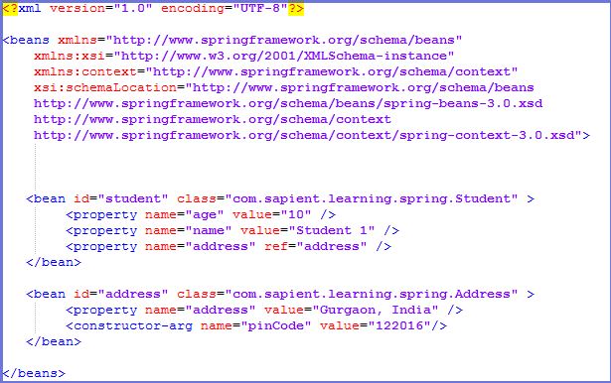
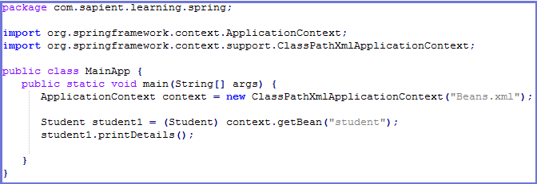
Setter-based dependency injection contd…
Sujata Batra

Slide 34
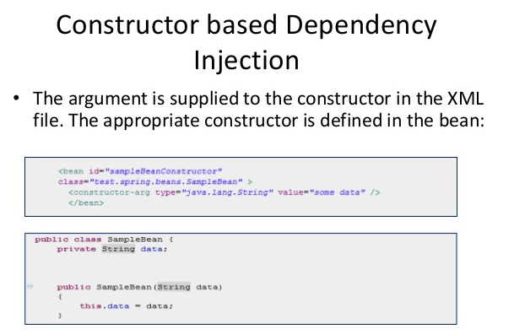
Sujata Batra
Notes:
Constructor-based DI is accomplished when the container invokes a class constructor with a number of arguments, each representing a dependency on other class.
There may be a ambiguity while passing arguments to the constructor in case there are more than one parameters. To resolve this ambiguity, the order in which the constructor arguments are defined in a bean definition is the order in which those arguments are supplied to the appropriate constructor.
The container can also use type matching with simple types if you explicitly specify the type of the constructor argument using the type attribute.
You can also use the index attribute to specify explicitly the index of constructor arguments. Here the index is 0 based.

Slide 35
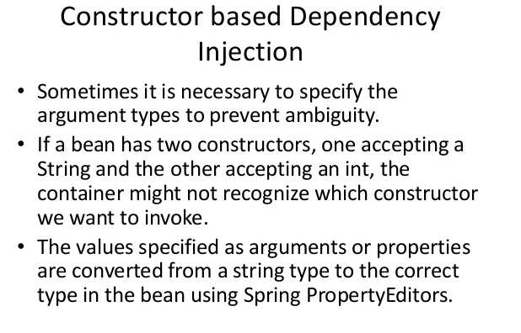
Sujata Batra
Notes:
Constructor-based DI is accomplished when the container invokes a class constructor with a number of arguments, each representing a dependency on other class.
There may be a ambiguity while passing arguments to the constructor in case there are more than one parameters. To resolve this ambiguity, the order in which the constructor arguments are defined in a bean definition is the order in which those arguments are supplied to the appropriate constructor.
The container can also use type matching with simple types if you explicitly specify the type of the constructor argument using the type attribute.
You can also use the index attribute to specify explicitly the index of constructor arguments. Here the index is 0 based.

Slide 36
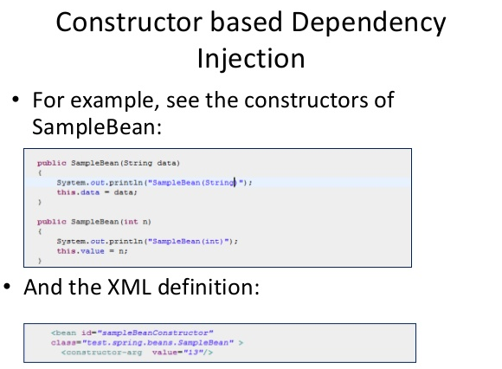
Sujata Batra
Notes:
Constructor-based DI is accomplished when the container invokes a class constructor with a number of arguments, each representing a dependency on other class.
There may be a ambiguity while passing arguments to the constructor in case there are more than one parameters. To resolve this ambiguity, the order in which the constructor arguments are defined in a bean definition is the order in which those arguments are supplied to the appropriate constructor.
The container can also use type matching with simple types if you explicitly specify the type of the constructor argument using the type attribute.
You can also use the index attribute to specify explicitly the index of constructor arguments. Here the index is 0 based.

Slide 37
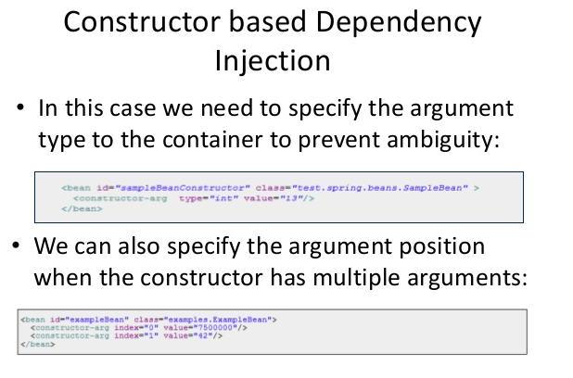
Sujata Batra
Notes:
Constructor-based DI is accomplished when the container invokes a class constructor with a number of arguments, each representing a dependency on other class.
There may be a ambiguity while passing arguments to the constructor in case there are more than one parameters. To resolve this ambiguity, the order in which the constructor arguments are defined in a bean definition is the order in which those arguments are supplied to the appropriate constructor.
The container can also use type matching with simple types if you explicitly specify the type of the constructor argument using the type attribute.
You can also use the index attribute to specify explicitly the index of constructor arguments. Here the index is 0 based.

Slide 38
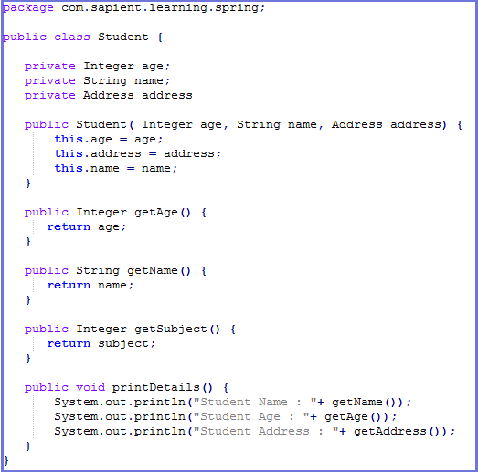
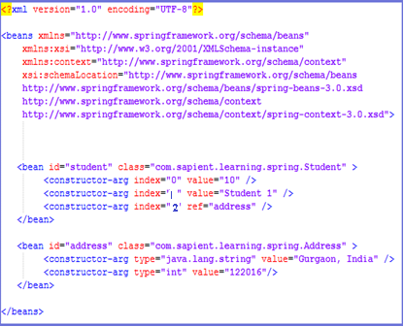
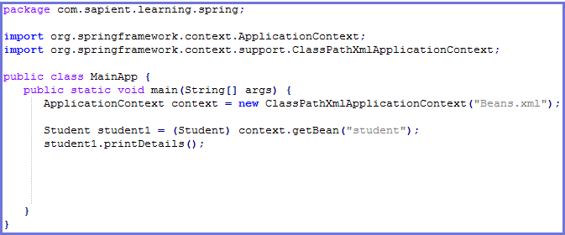
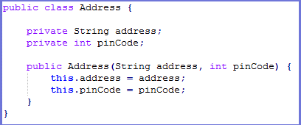
Constructor-based dependency injection contd…
Sujata Batra
Student.java
Beans.xml
MainApp.java
Address.java

Slide 39
Exercise
Sujata Batra
Modify student bean created earlier to demonstrate constructor & setter based injection.
Include both injection techniques in the same bean and check which one is overridden.

Slide 40
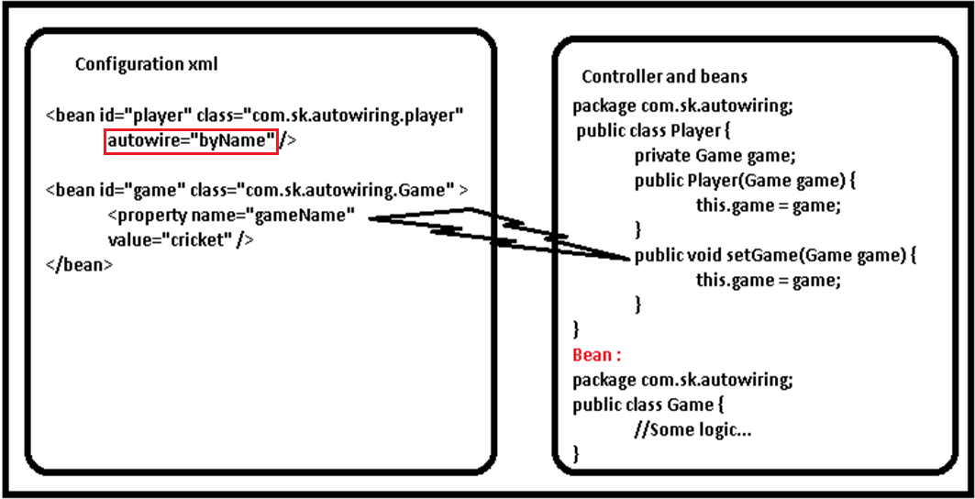
Beans Auto-Wiring
Sujata Batra
Notes:
The Spring container can autowire relationships between collaborating beans without using <constructor-arg> and <property> elements which helps cut down on the amount of XML configuration you write for a big Spring based application.
You use the autowire attribute of the <bean/> element to specify autowire mode for a bean definition. There are following autowiring modes which can be used to instruct Spring container to use autowiring for dependency injection :

Slide 41
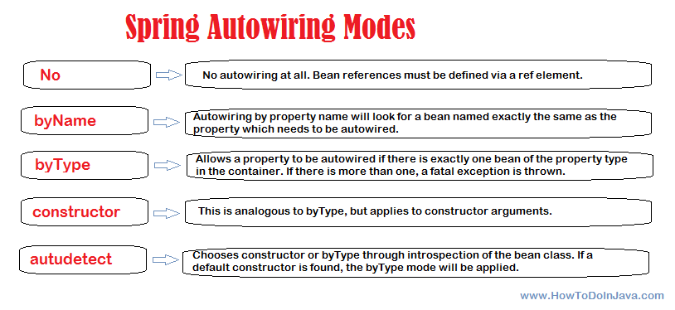
Beans Auto-Wiring contd…
Sujata Batra
Notes:
https://www.tutorialspoint.com/spring/spring_autowiring_byconstructor.htm
https://www.mkyong.com/spring/spring-autowiring-by-autodetect/

Slide 42
Autowiring 'byName'
Sujata Batra
Notes:
This mode specifies autowiring by property name. Spring container looks at the beans on which auto-wire attribute is set to byName in the XML configuration file.
It then tries to match and wire its properties with the beans defined by the same names in the configuration file. If matches are found, it will inject those beans otherwise, it will throw exceptions.

Slide 43
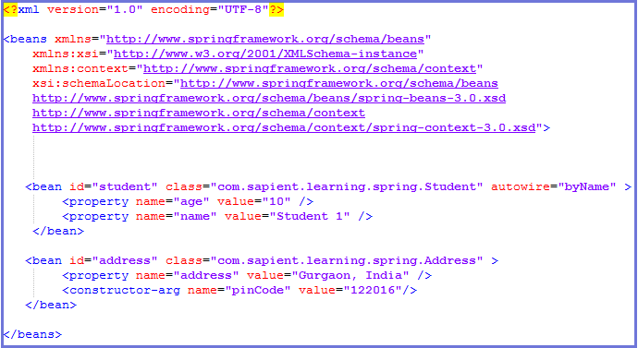
Autowiring 'byName‘ contd…
Sujata Batra

Slide 44
Autowiring 'byType'
Sujata Batra
Notes:
Spring container looks at the beans on which autowire attribute is set to byType in the XML configuration file.
It then tries to match and wire a property if its type matches with exactly one of the beans name in configuration file. If matches are found, it will inject those beans otherwise, it will throw exceptions.

Slide 45

Autowiring ‘byType’ contd…
Sujata Batra

Slide 46
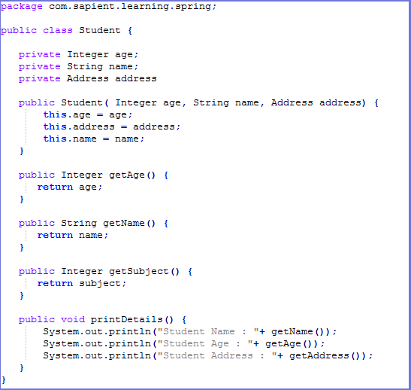
Autowiring by Constructor
Sujata Batra
Notes:
This mode is very similar to byType, but it applies to constructor arguments.
Spring container looks at the beans on which autowire attribute is set to constructor in the XML configuration file. It then tries to match and wire its constructor's argument with exactly one of the beans name in configuration file.
If matches are found, it will inject those beans otherwise, it will throw exceptions.

Slide 47
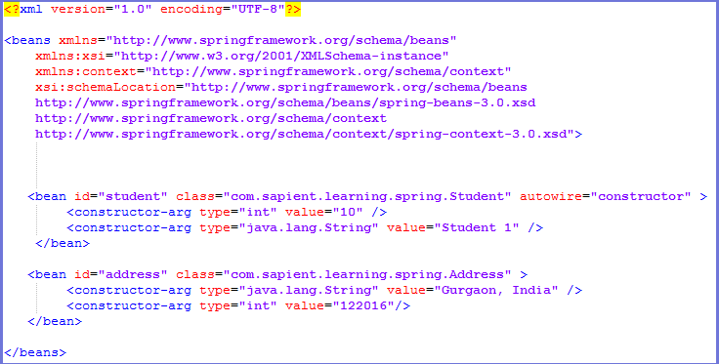
Autowiring by Constructor contd…
Sujata Batra

Slide 48
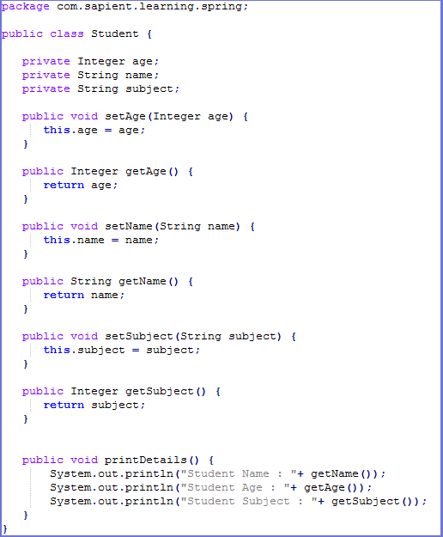
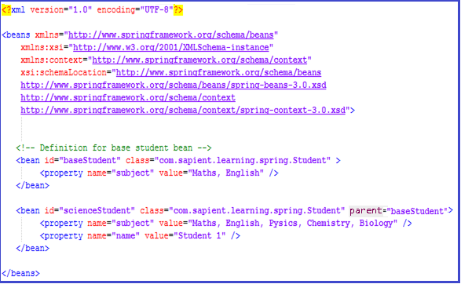
Bean Definition Inheritance
Sujata Batra
Bean definition can be inherited.
Notes:
A bean definition can contain a lot of configuration information, including constructor arguments, property values, and container-specific information such as initialization method, static factory method name, and so on.
A child bean definition inherits configuration data from a parent definition. The child definition can override some values, or add others, as needed.
You can define a parent bean definition as a template and other child beans can inherit required configuration from the parent bean.
When you use XML-based configuration metadata, you indicate a child bean definition by using the parent attribute, specifying the parent bean as the value of this attribute.

Slide 49
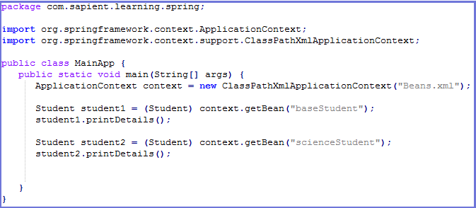
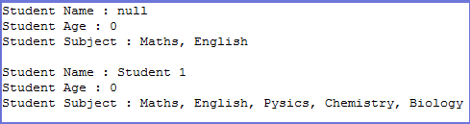
Bean Definition Inheritance contd…
Sujata Batra

Slide 50
Exercise
Sujata Batra
Modify student bean to autowire the field references using different autowire strategies-byname, byType & constructor.
Include all in the same bean and check which one takes priority.
Include a cyclic dependency and see the Exception.
Debug it using ApplicationContextAware & BeanPostProcessor.

Slide 51
Injecting Inner Beans
Sujata Batra
inner beans are beans that are defined within the scope of another bean.
a <bean/> element inside the <property/> or <constructor-arg/> elements is called inner bean and it is shown below :

Slide 52
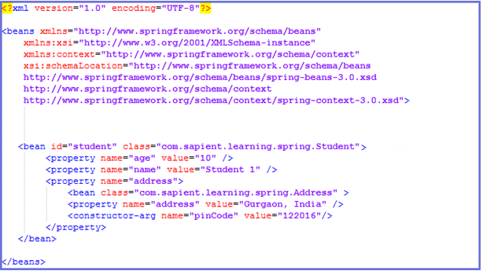
Injecting Inner Beans contd…
Sujata Batra

Slide 53

Sujata Batra
Notes:
You can use either <list> or <set> to wire any implementation of java.util.Collection or an array. You will come across two situations :
Passing direct values of the collection and
Passing a reference of a bean as one of the collection elements

Slide 54



Injecting Collections contd…
Sujata Batra

Slide 55

Injecting bean references
Sujata Batra
If you want to inject bean references then use the ref element :

Slide 56

Merging collections
Sujata Batra
Notes:
According to the need, we can merge collection data while creating bean.
There will be a parent and child bean. Child will inherit the parent data.
It is done by the attribute merge="true".
This attribute is available in all collection tags like <list/>, <set/>, <map/> and <props/> .

Slide 57



Merging collections contd…
Sujata Batra

Slide 58
Exercise
Sujata Batra
Inject address bean as in inner bean in student.
Inject address bean as a collection in student bean. Inject it using list, set & map.
Use merge option and check whether collection is merged or not.

Slide 59

Sujata Batra
Factory Method
Normally, Spring instantiates a class and performs dependency injection. However, sometimes it may be necessary to instantiate a class via another class
In such a scenario, Spring should not create the class on its own but simply delegate the instantiation to the Factory class.
Spring provides a way to delegate class instantiation to another class by using factory-method attribute of bean tag
Notes:
http://howtodoinjava.com/spring/spring-core/spring-create-beans-using-static-factory-method/

Slide 60

Sujata Batra
Factory Method contd…
Notes:
http://www.concretepage.com/spring/example_factory_method_spring

Slide 61


Sujata Batra
Factory Method contd…
Notes:
http://howtodoinjava.com/spring/spring-core/spring-create-beans-using-static-factory-method/

Slide 62
Sujata Batra
Exercise
Create a student bean which has a reference to other beans like address etc. and other fields as well.
Create a sample Spring application using BeanFactory having these POJO’s and configure the main application to display details of a particular student based on name and id.
Repeat the same using ApplicationContext.
Repeat the same by creating a Factory method.

Slide 63

Sujata Batra

Slide 64

Sujata Batra

Slide 65



@Required annotation contd…
Sujata Batra

Slide 66

Sujata Batra
Notes:
https://www.java2novice.com/spring/autowired-annotation/
The @Autowired annotation can be used to autowire bean on the setter method just like @Required annotation, constructor, a property or methods with arbitrary names and/or multiple arguments.
When Spring finds an @Autowired annotation used with setter methods, it tries to perform byType autowiring on the method.
The @Autowired annotation can be applied on setters, properties & constructors.
By default, the @Autowired annotation implies the dependency is required similar to @Required annotation, however, you can turn off the default behavior by using (required=false) option with @Autowired.
To explain @Autowired annotation the following 5 files are there :
Student.java : It has 2 fields-age & name and getters & setters.
Address.java : It stores student address and is a POJO
Subject.java : It stores student’s subject and is a POJO
MainApp.java : gets student bean and prints name & age
Beans.xml : spring configuration file which includes all the possible places where we can have @Autowired annotation

Slide 67




@Autowired annotation contd…
Sujata Batra
Notes:
https://www.java2novice.com/spring/autowired-annotation/

Slide 68

Sujata Batra
Notes:
There may be a situation when you create more than one bean of the same type and want to wire only one of them with a property, in such case you can use @Qualifier annotation along with @Autowired to remove the confusion by specifying which exact bean will be wired.
To explain @Qualifier annotation the following 4 files are there :
Student.java : It has 2 fields-age & name and getters & setters.
Profile.java : It has dependency on Student object which is resolved using @Qualifier annotation
MainApp.java : gets student bean and prints name & age
Beans.xml : spring configuration file

Slide 69




@Qualifier annotation contd…
Sujata Batra
Profile.java
Beans.xml
MainApp.java
Student.java

Slide 70
Exercise
Sujata Batra
Modify the sample Student application created earlier to configure the beans using annotation.
Use @Required in id and name and try to define beans with/without the mandatory fields and observe the exception.
Use @Autowired annotation to wire the beans
Use @Qualifier to mark 2 or more address beans that belong to a particular student and display the address details.

Slide 71

Sujata Batra

Slide 72

Sujata Batra

Slide 73
Sujata Batra
Spring Bean Scopes
Notes:
This is the simplest container providing basic support for DI and defined by the org.springframework.beans.factory.BeanFactory interface. A BeanFactory is essentially nothing more than the interface for an advanced factory capable of maintaining a registry of different beans and their dependencies.
There are a number of implementations of the BeanFactory interface that come supplied straight out-of-the-box with Spring. The most commonly used BeanFactory implementation is the XmlBeanFactory class. This container reads the configuration metadata from an XML file and uses it to create a fully configured system or application.
The BeanFactory is usually preferred where the resources are limited like mobile devices or applet based applications.
To explain the concept we have created following 3 files :
HelloWorld.java : Simple Java POJO having just a getter and setter
MainApp.java : Creates a BeanFactory and gets HelloWorld bean
Beans.xml : XML bean configuration file

Slide 74

Sujata Batra
Spring Bean Scopes
Notes:
When defining a <bean> in Spring, you have the option of declaring a scope for that bean.
The Spring Framework supports following five scopes, three of which are available only if you use a web-aware ApplicationContext.
singleton : This scopes the bean definition to a single instance per Spring IoC container (default)
prototype : This scopes a single bean definition to have any number of object instances.
request : This scopes a bean definition to an HTTP request. Only valid in the context of a web-aware Spring ApplicationContext.
session : This scopes a bean definition to an HTTP session. Only valid in the context of a web-aware Spring ApplicationContext.
global-session : This scopes a bean definition to a global HTTP session. Only valid in the context of a web-aware Spring ApplicationContext.

Slide 75

Sujata Batra
Notes:
When defining a <bean> in Spring, you have the option of declaring a scope for that bean.
The Spring Framework supports following five scopes, three of which are available only if you use a web-aware ApplicationContext.
singleton : This scopes the bean definition to a single instance per Spring IoC container (default)
prototype : This scopes a single bean definition to have any number of object instances.
request : This scopes a bean definition to an HTTP request. Only valid in the context of a web-aware Spring ApplicationContext.
session : This scopes a bean definition to an HTTP session. Only valid in the context of a web-aware Spring ApplicationContext.
global-session : This scopes a bean definition to a global HTTP session. Only valid in the context of a web-aware Spring ApplicationContext.

Slide 76

Singleton scope
Sujata Batra
Notes:
If scope is set to singleton, the Spring IoC container creates exactly one instance of the object defined by that bean definition. The default scope is singleton.
This single instance is stored in a cache of such singleton beans, and all subsequent requests and references for that named bean return the cached object.
Spring’s concept of a singleton bean differs from the Singleton pattern as defined in the Gang of Four (GoF) patterns book. The GoF Singleton hard-codes the scope of an object such that one and only one instance of a particular class is created per ClassLoader.
The scope of the Spring singleton is best described as per container and per bean. This means that if you define one bean for a particular class in a single Spring container, then the Spring container creates one and only one instance of the class defined by that bean definition.
To explain the concept further the following 3 files are there :
Student.java : It has 2 fields-age & name and getters & setters.
MainApp.java : gets student bean and prints name
Beans.xml : spring configuration file

Slide 77




Singleton scope contd…
Sujata Batra
Beans.xml
Student.java
MainApp.java
Output

Slide 78

Prototype scope
Sujata Batra
Notes:
If scope is set to prototype, the Spring IoC container creates new bean instance of the object every time a request for that specific bean is made.
As a rule, use the prototype scope for all state-full beans and the singleton scope for stateless beans.
To explain the concept further the following 3 files are there :
Student.java : It has 2 fields-age & name and getters & setters.
MainApp.java : gets student bean and prints name
Beans.xml : spring configuration file

Slide 79


Prototype scope contd…
Sujata Batra
Beans.xml
Student.java
MainApp.java
Output

Slide 80


Injecting prototype bean in singleton bean in Spring
Sujata Batra
Notes:
http://netjs.blogspot.in/2016/02/injecting-prototype-bean-in-singleton-spring.html

Slide 81



Injecting prototype bean in singleton bean in Spring (Contd.)
Sujata Batra
Notes:
http://netjs.blogspot.in/2016/02/injecting-prototype-bean-in-singleton-spring.html

Slide 82



Injecting prototype bean in singleton bean in Spring (Contd.)
Sujata Batra
Notes:
http://netjs.blogspot.in/2016/02/injecting-prototype-bean-in-singleton-spring.html

Slide 83

Bean Lifecycle
Sujata Batra
Notes:
Spring bean factory is responsible for managing the life cycle of beans created through spring container. The life cycle of beans consist of call back methods which can be categorized broadly in two groups:
Post initialization call back methods
Pre destruction call back methods

Slide 84

Bean Lifecycle Contd.
Sujata Batra

Slide 85

Sujata Batra

Slide 86



InitializingBean & DisposableBean callback interfaces contd…
Sujata Batra
Beans.xml
Student.java
MainApp.java

Slide 87


Custom init & destroy methods
Sujata Batra
In the case of XML-based configuration metadata, you can use the init-method attribute to specify the name of the method that has a void no-argument signature.
Similarly you can use the destroy-method attribute to specify the name of the method that has a void no-argument signature.
Student.java
Beans.xml

Slide 88

Sujata Batra

Slide 89

@PostConstruct and @PreDestroy annotations
Sujata Batra
Notes:
Spring 2.5 onwards, you can use annotations also for specifying life cycle methods using @PostConstruct and @PreDestroy annotations.
@PostConstruct annotated method will be invoked after the bean has been constructed using default constructor and just before it’s instance is returned to requesting object.
@PreDestroy annotated method is called just before the bean is about be destroyed inside bean container.

Slide 90
Exercise
Sujata Batra
In the Student application created earlier define student and address bean as singleton and do a getBean multiple times in main application and check whether same bean is returned or not. Repeat the same by marking address bean as prototype and observe what happens.
Use InitializingBean and DisposableBean callback interfaces in student bean to display bean construction and display messages. Repeat the same using aware interfaces, custom init() & destroy() and @PostConstruct and @PreDestroy annotations.

Slide 91

Circular Dependencies in Spring
Sujata Batra
org.springframework.beans.factory.BeanCreationException: Error creating bean with name ‘beanName’ defined in class path resource []:Cannot resolve reference to bean ‘beanName’ while setting bean property ‘beanName’; nested exception is org.springframework.beans.factory.BeanCurrentlyInCreationException: Error creating bean with name ‘beanName’: Bean with name ‘beanName’ has been injected into other beans [beanName2] in its raw version as part of a circular reference, but has eventually been wrapped (for example as part of auto-proxy creation).
The error is caused because Spring is trying to effectively inject two semi-initialized proxy beans into one another.

Slide 92
Circular Dependencies in Spring
Sujata Batra
There are 4 possible technique for dealing with this problem :
Refactor your code
Use @Lazy
Use Setter/Field Injection
Implement ApplicationContextAware and InitializingBean
Using PostConstruct method
Use a BeanPostProcessor

Slide 93
Circular Dependencies in Spring contd…
Sujata Batra
Refactor your Code
Look at your code, analyse why your two beans are referencing one another.
Consider creating a third bean that both other beans can be injected into which will perform the
functionality that requires the different dependencies.
Refactor your design and simplify your structure

Slide 94

Circular Dependencies in Spring contd…
Sujata Batra

Slide 95


Circular Dependencies in Spring contd…
Sujata Batra
Use Setter/Field Injection
Notes:
If one of the beans implements ApplicationContextAware, the bean has access to Spring context and can extract the other bean from there. Implementing InitializingBean we indicate that this bean has to do some actions after all its properties have been set; in this case, we want to manually set our dependency.
http://www.baeldung.com/circular-dependencies-in-spring

Slide 96

Circular Dependencies in Spring contd…
Sujata Batra
Use @Lazy
Notes:
If one of the beans implements ApplicationContextAware, the bean has access to Spring context and can extract the other bean from there. Implementing InitializingBean we indicate that this bean has to do some actions after all its properties have been set; in this case, we want to manually set our dependency.
http://www.baeldung.com/circular-dependencies-in-spring

Slide 97

Circular Dependencies in Spring contd…
Sujata Batra
default-lazy-init="true"
Notes:
https://dzone.com/articles/resolve-circular-dependency

Slide 98
Circular Dependencies in Spring contd…
Sujata Batra
Implement ApplicationContextAware and InitializingBean
@Component
public class CircularDependencyA implements ApplicationContextAware, InitializingBean {
private CircularDependencyA circB;
private ApplicationContext context;
public CircularDependencyB getCircB() {
return circB;
}
@Override
public void afterPropertiesSet() throws Exception {
circB = context.getBean(CircularDependencyB.class);
}
@Override
public void setApplicationContext(final ApplicationContext ctx) throws BeansException {
context = ctx;
}
}
Notes:
If one of the beans implements ApplicationContextAware, the bean has access to Spring context and can extract the other bean from there. Implementing InitializingBean we indicate that this bean has to do some actions after all its properties have been set; in this case, we want to manually set our dependency.
http://www.baeldung.com/circular-dependencies-in-spring

Slide 99


Circular Dependencies in Spring contd…
Sujata Batra
using @Autowired on one of the beans, and then use a method annotated with @PostConstruct to set the other dependency.
Notes:
http://www.baeldung.com/circular-dependencies-in-spring

Slide 100
Circular Dependencies in Spring contd…
Sujata Batra
Use a BeanPostProcessor
Create a bean that implements Spring’s BeanPostProcessor interface and use this to initialize any of the properties in
beans that cannot be initialized using IoC due to circular dependency problems.

Slide 101

Sujata Batra
Notes:
The BeanPostProcessor interface defines callback methods that you can implement to provide your own instantiation logic, dependency-resolution logic etc.
You can also implement some custom logic after the Spring container finishes instantiating, configuring, and initializing a bean by plugging in one or more BeanPostProcessor implementations.
You can configure multiple BeanPostProcessor interfaces and you can control the order in which these BeanPostProcessor interfaces execute by setting the order property provided the BeanPostProcessor implements the Ordered interface.
An ApplicationContext automatically detects any beans that are defined with implementation of the BeanPostProcessor interface and registers these beans as post-processors, to be then called appropriately by the container upon bean creation.

Slide 102

Bean Post Processors contd…
Sujata Batra
Notes:
http://www.concretepage.com/spring/example_beanpostprocessor_spring

Slide 103

Bean Post Processors contd…
Sujata Batra
Notes:
http://www.concretepage.com/spring/example_beanpostprocessor_spring

Slide 104

Bean Post Processors contd…
Sujata Batra
Notes:
http://www.concretepage.com/spring/example_beanpostprocessor_spring

Slide 105


Bean Post Processors contd…
Sujata Batra
Notes:
http://www.concretepage.com/spring/example_beanpostprocessor_spring

Slide 106




Event Handling in Spring
Sujata Batra

Slide 107
Custom Events
Sujata Batra
There are a few simple guidelines to follow:
the event should extend ApplicationEvent
the publisher should inject an ApplicationEventPublisher object
the listener should implement the ApplicationListener interface
Notes:
Event publishing is one of the capabilities provided by ApplicationContext.
Spring allows to create and publish custom events which – by default – are synchronous. This has a few advantages – such as, for example the listener being able to participate in the publisher’s transaction context.
The publisher constructs the event object and publishes it to anyone who’s listening.
The only requirement for the listener is to be a bean and implements ApplicationListener interface.

Slide 108


Custom Events Use Case
Sujata Batra
Notes:
The use case for custom events is the same that we have been using throughout this tutorial- a student bean
Whenever a new student bean is requested from IOC container, a custom event is published
The files are :
StudentEvent.java : custom student event which extends ApplicationEvent and stores the student bean that was created
StudentEventPublisher.java : publishes StudentEvent whenever student bean is created
StudentEventHandler.java : Listens to StudentEvent and can do processing on Student object
Student.java : Student POJO
MainApp.java : gets student bean and publishes StudentEvent
Beans.xml : Spring configuration

Slide 109




Custom Events contd…

Slide 110
Exercise
Define a bean PostProcessor in the student bean and display student bean details in the callback methods.
Define an abstract bean student and extend it to have 3 children-ScienceStudent, CommerceStudent & ArtsStudent.
In the abstract bean define static properties like id, name, address etc.
In the child beans define stream specific fields for eg. in ScienceStudent define Physics, Chemistry, Maths as subjects.
Use Bean definition inheritance and display student details with/without overriding abstract bean definitions.

Slide 111
Disadvantage of Spring
Sujata Batra
In the early days of Spring, it offered a simpler programming model compared to ejb 2.0. Today that advantage is gone. The JEE spec has evolved and easier to use.
there are no specs when it comes to Spring. Just one company engineering a framework.
Spring can do a lot, integrate with a lot of frameworks, but getting to know all the options requires time.
One of the major criticisms faced by the Spring framework is that it is complex! No so clear focus, more than 2400 classes, 49 other tools and tons of the other things make it complicated for the developers.

Slide 112
Favorite Questions
Sujata Batra
What is Cyclic dependency in Spring and how you will find there is a cyclic dependency ?
How you will remove Spring Cyclic dependency ?
Suppose I have two beans, One is Prototype and another is Singleton and I am using Singleton reference in
my Prototype bean then how many objects are created ?
How many objects are created on 2nd request after Question 3
How Spring support dependency injection
What are all the ways of dependency injection provided by Spring.
Auto Wiring. How it is done in spring.
Annotations for Auto wiring.
All the scopes and their details.
Is spring's singleton bean scope is similar as the Java Singleton pattern?
Spring bean life Cycle

Slide 113
Recap
Sujata Batra
Basic understanding of Spring framework.
Working of Spring container and inversion of Control(IOC)
Spring Beans configuration
Bean Scopes
Dependency Injection
Event Handling
Disadvantages of Spring

